Slide 1

BLOOD BANK MANAGEMENT SYSTEM

Slide 2
Aleena Augustine Gomez Aleena M Georgy Shalu Shyjan
GROUP MEMBERS

Slide 3
CONTENTS
Importance of blood donation?
Present System
Advantages of the designed system
System Overview

Slide 4
IMPORTANCE OF BLOOD DONATION
Blood donation refers to the process of collecting, testing, preparing, and storing blood and blood components. Donors are most commonly unpaid volunteers, but they may also be paid by commercial enterprises.
The purpose of the blood collection and distribution system is to help ensure an adequate supply of blood for accident victims, people needing surgery, and people suffering from certain diseases, as well as for medical research.

Slide 5
PRESENT SYSTEM
LIMITATIONS OF MANUAL SYSTEM
Time Consuming
Leads to error prone results
Consumes lot of man power
Tracking of donor information
Uncertainty of donor availability
Retrieval of data takes a lot of time
Percentage of accuracy is less

Slide 6
DESIGNED SYSTEM
ADVANTAGES OVER MANUAL SYSTEM
Access from anywhere of the world
Access at any time
Quick search
Better communication
Time optimize
Cost optimize

Slide 7
OBJECTIVES
To provide a means for the blood bank to publicize and advertise blood donation programs.
To allow the probable recipients to make search and match the volunteer donors, and make request for the blood.
To provide an efficient donor and blood stock management functions to the blood bank by recording the donor and blood details.
To improve the efficiency of blood stock management by alerting the blood bank staffs when the blood quantity is below it par level or when the blood stock has expired.
To provide synchronized and centralized donor and blood stock database.
To provide immediate storage and retrieval of data and information.

Slide 8
SCOPE
The system can be extended to be used for maintaining records of hospital, organ donation and other similar sectors.
A smart phone application of the system can be made.
Collection of blood
Storage of blood
Transportation of blood.

Slide 9
FUNCTIONS
Generating reports on Stocks-Blood Group wise, area wise
Track and maintain all the donor types
Accurate database Record Management.
Blood Cross Match and Result Storage Facility
Comprehensive Donor database with Search Facility.
Admin can manage the web pages
Admin can add and delete donor as well as donor details

Slide 10
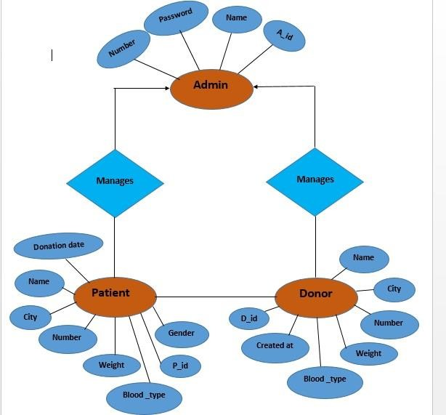
ER DIAGRAM

Slide 11
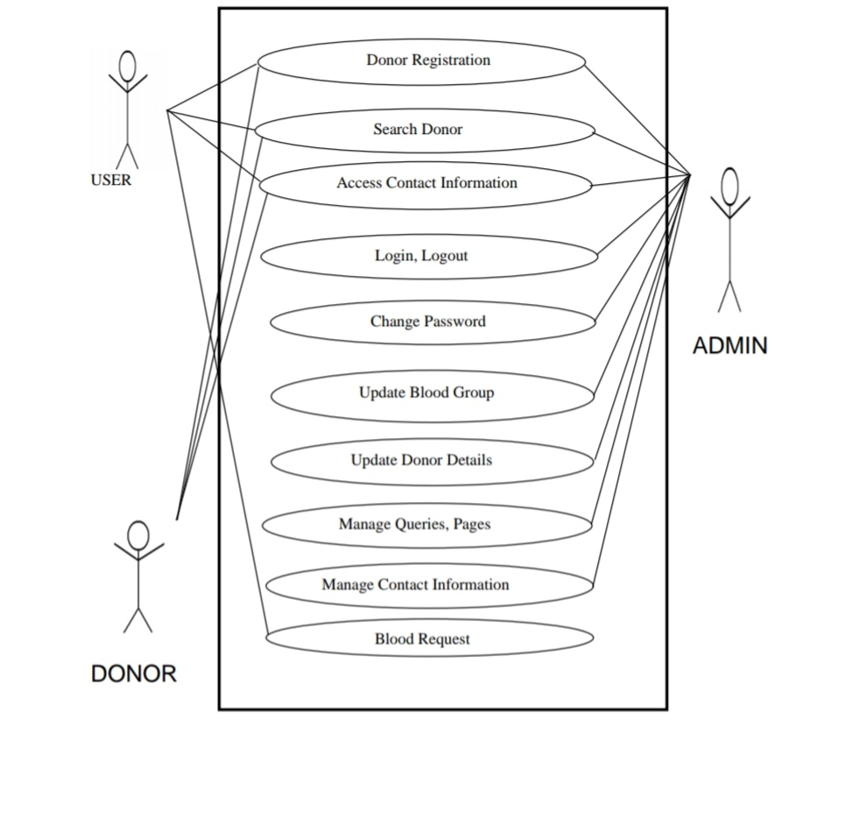
USE CASE DIAGRAM

Slide 12
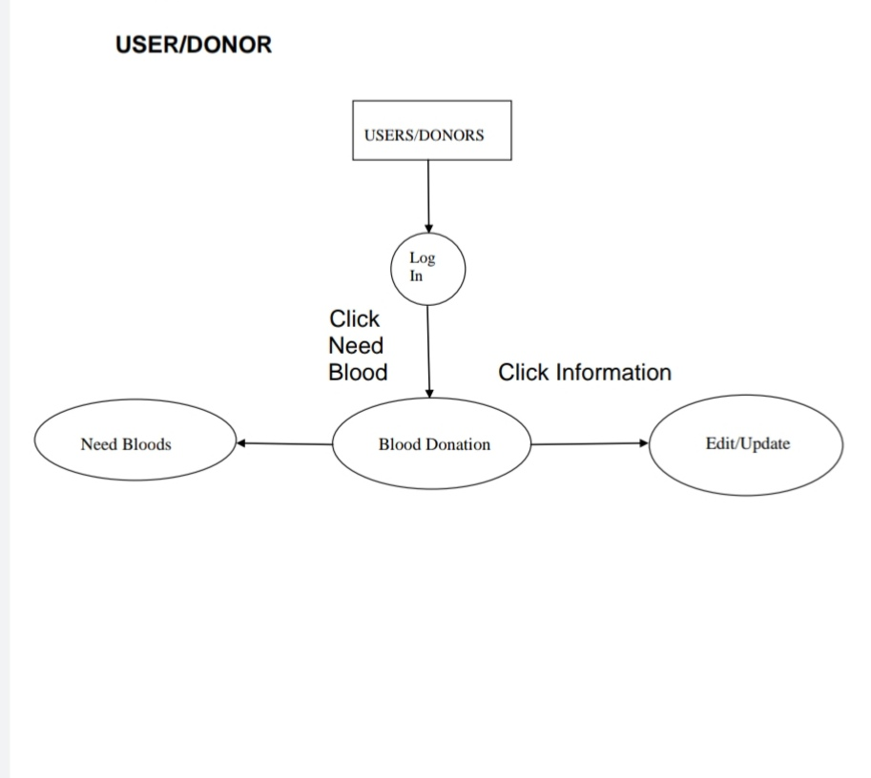
MODULES OF THE SYSTEM
USER

Slide 13
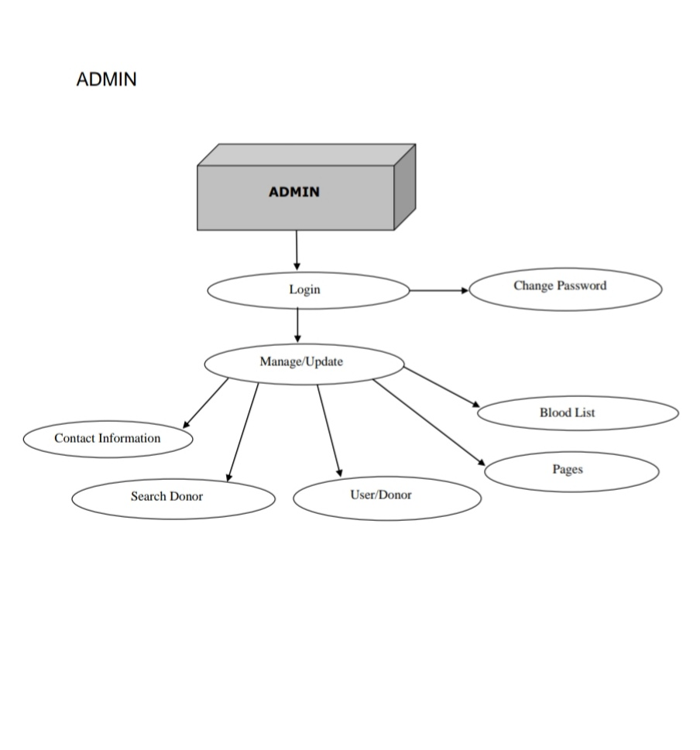
MODULES OF THE SYSTEM
ADMIN

Slide 14
USER
Users are the ones who can view the system.
Functionalities of user:
Can register to donate blood
Search blood donor
Can view the details of donor
Request or report to the admin panel

Slide 15
ADMIN
Admins are the ones who can observe and maintain the system.
The functionalities are:
1.Log in
2.Maintain Donor details
3.Update and change Database
4.To Observe and remove donor
5.Logout
Admin maintains the security of the system

Slide 16
SYSTEM REQUIREMENTS
Hardware
Processor Intel P4 1.5GHz or above
RAM 512Mb RAM
Hard-Disk 40 GB Hard-Disk or more

Slide 17
SYSTEM REQUIREMENTS
Software
Operating System Windows
Server WAMP
Web Technologies PHP
Database MySQL
Front End HTML, CSS, Bootstrap

Slide 18
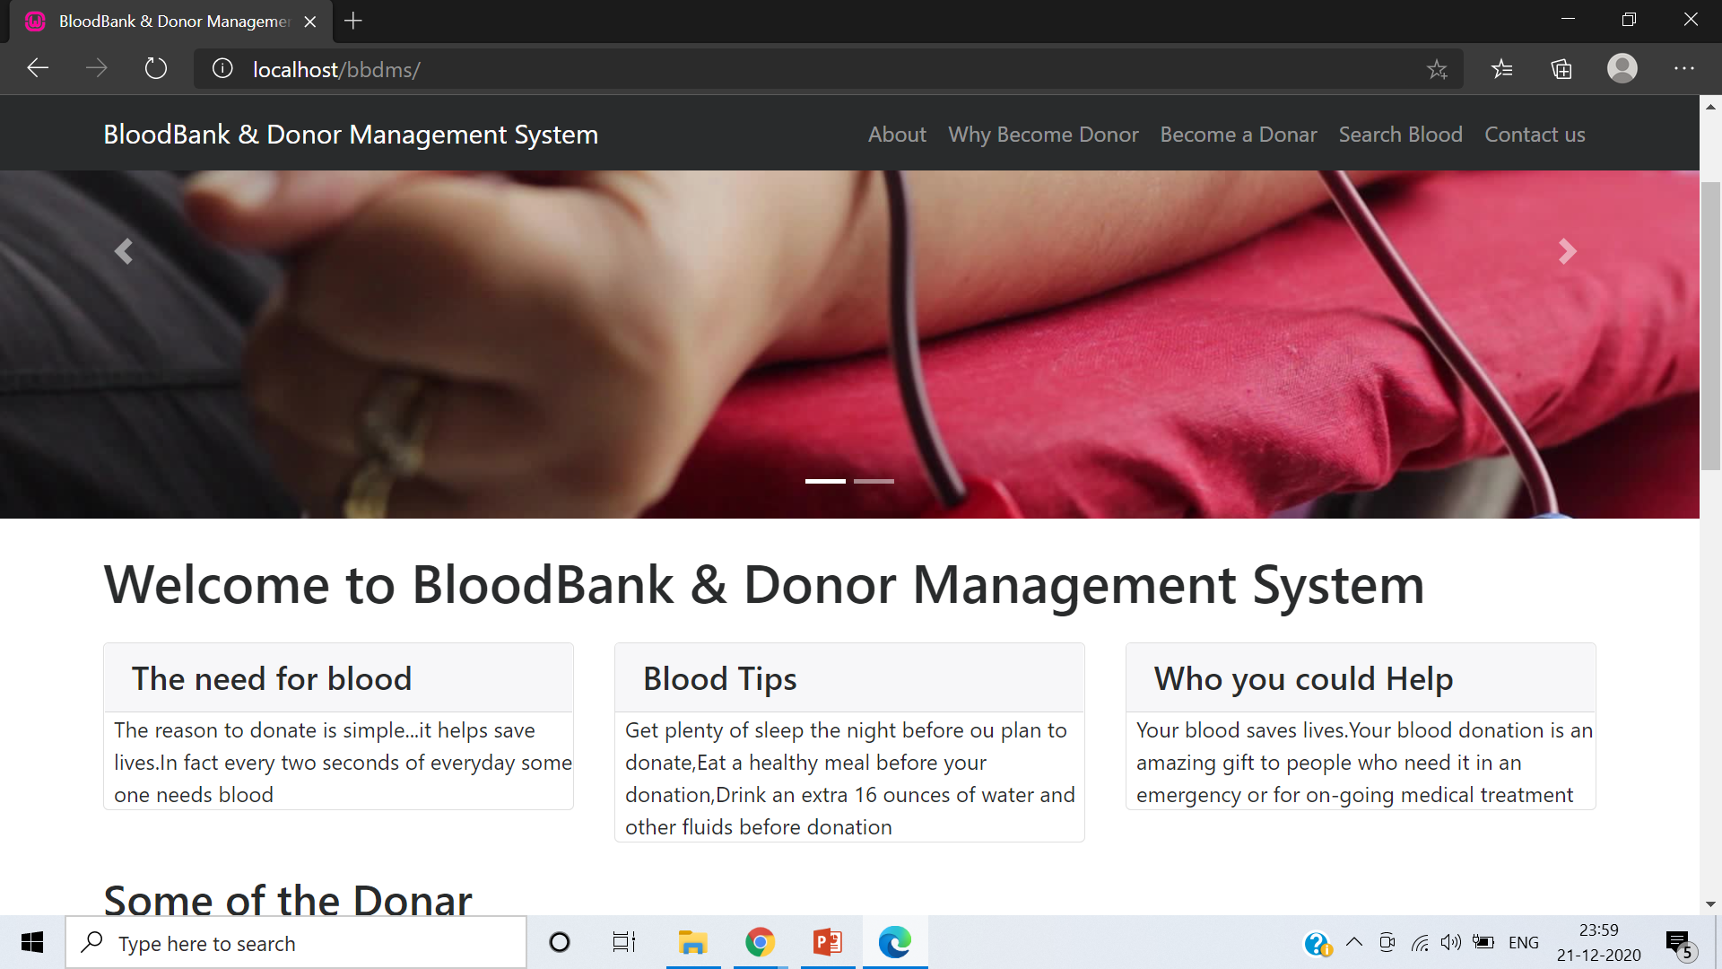
HOME PAGE

Slide 19
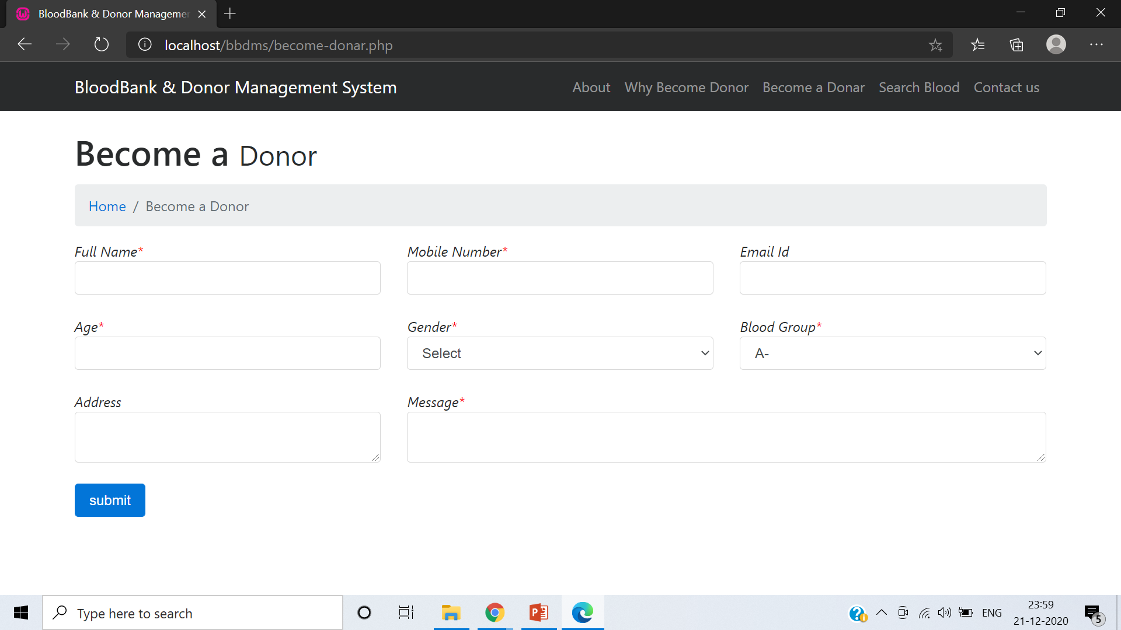
DONOR REGISTRATION PAGE

Slide 20
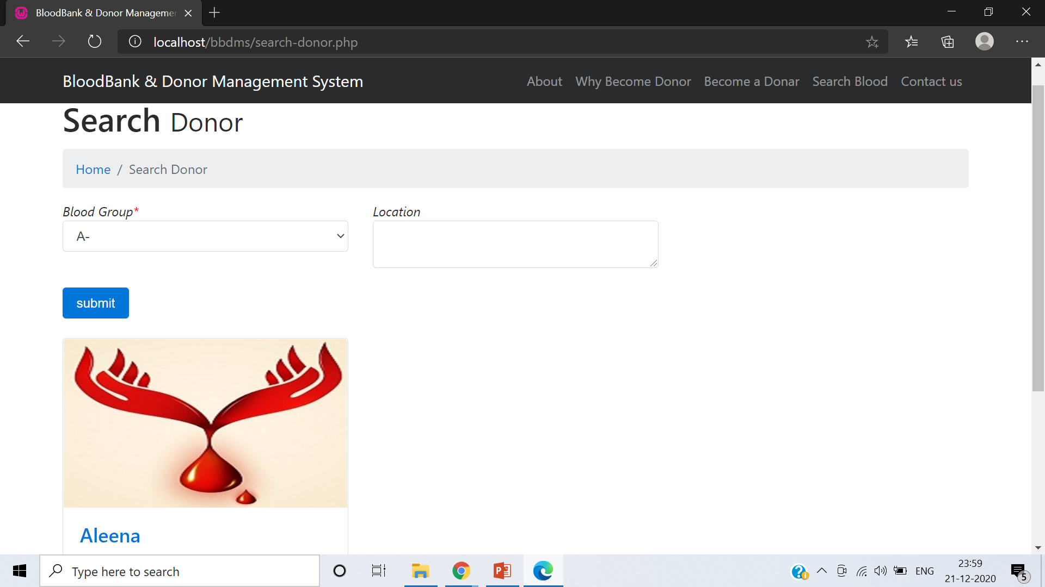
DONOR SEARCH PAGE

Slide 21
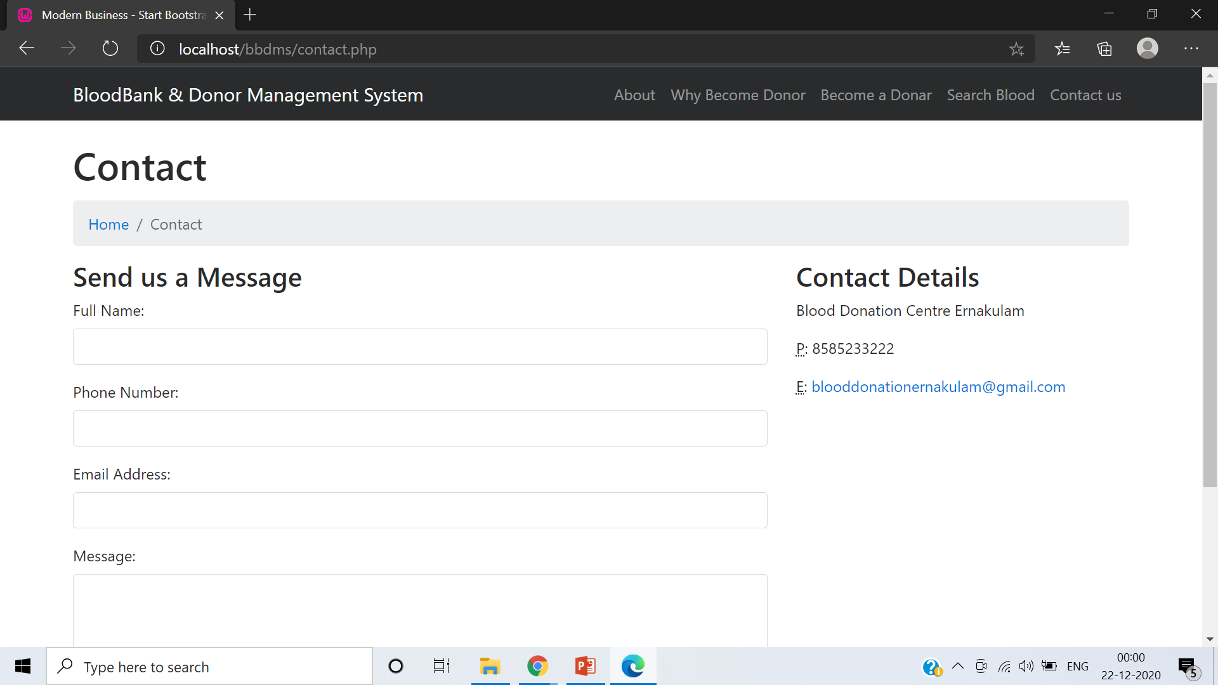
CONTACT PAGE

Slide 22
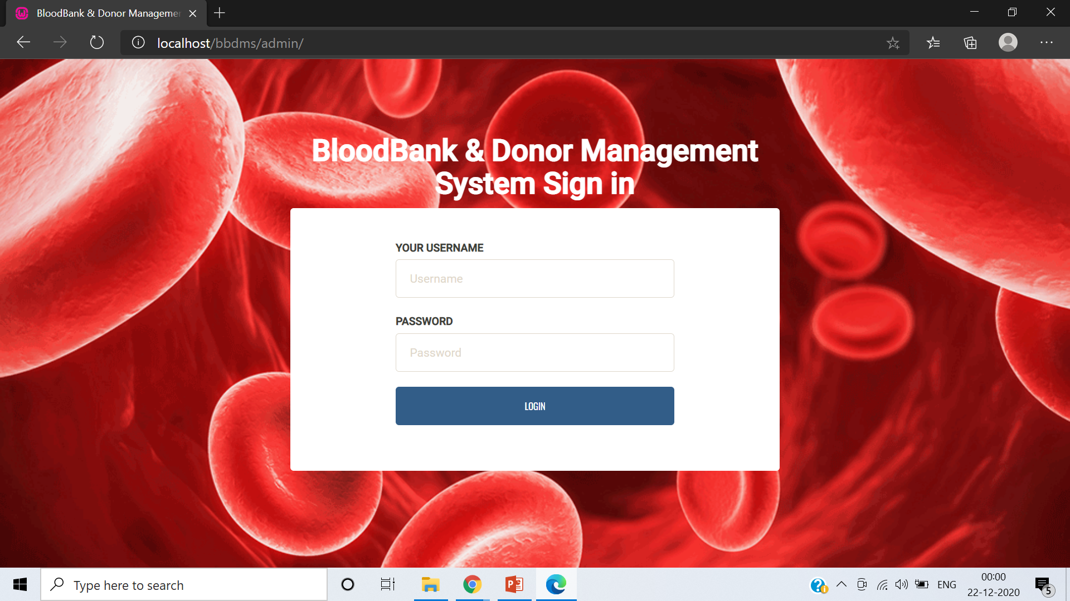
ADMIN LOGIN PAGE

Slide 23
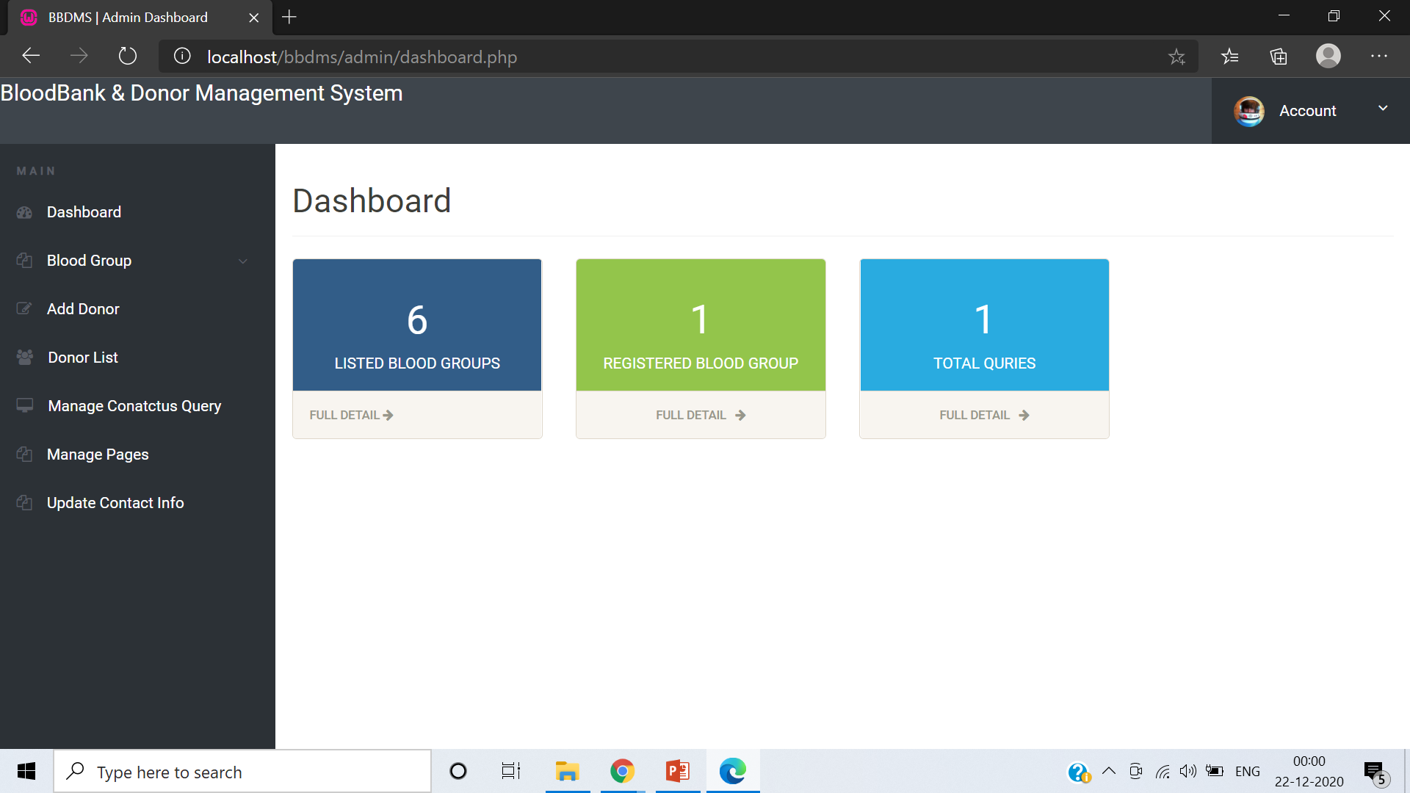
ADMIN PAGE

Slide 24
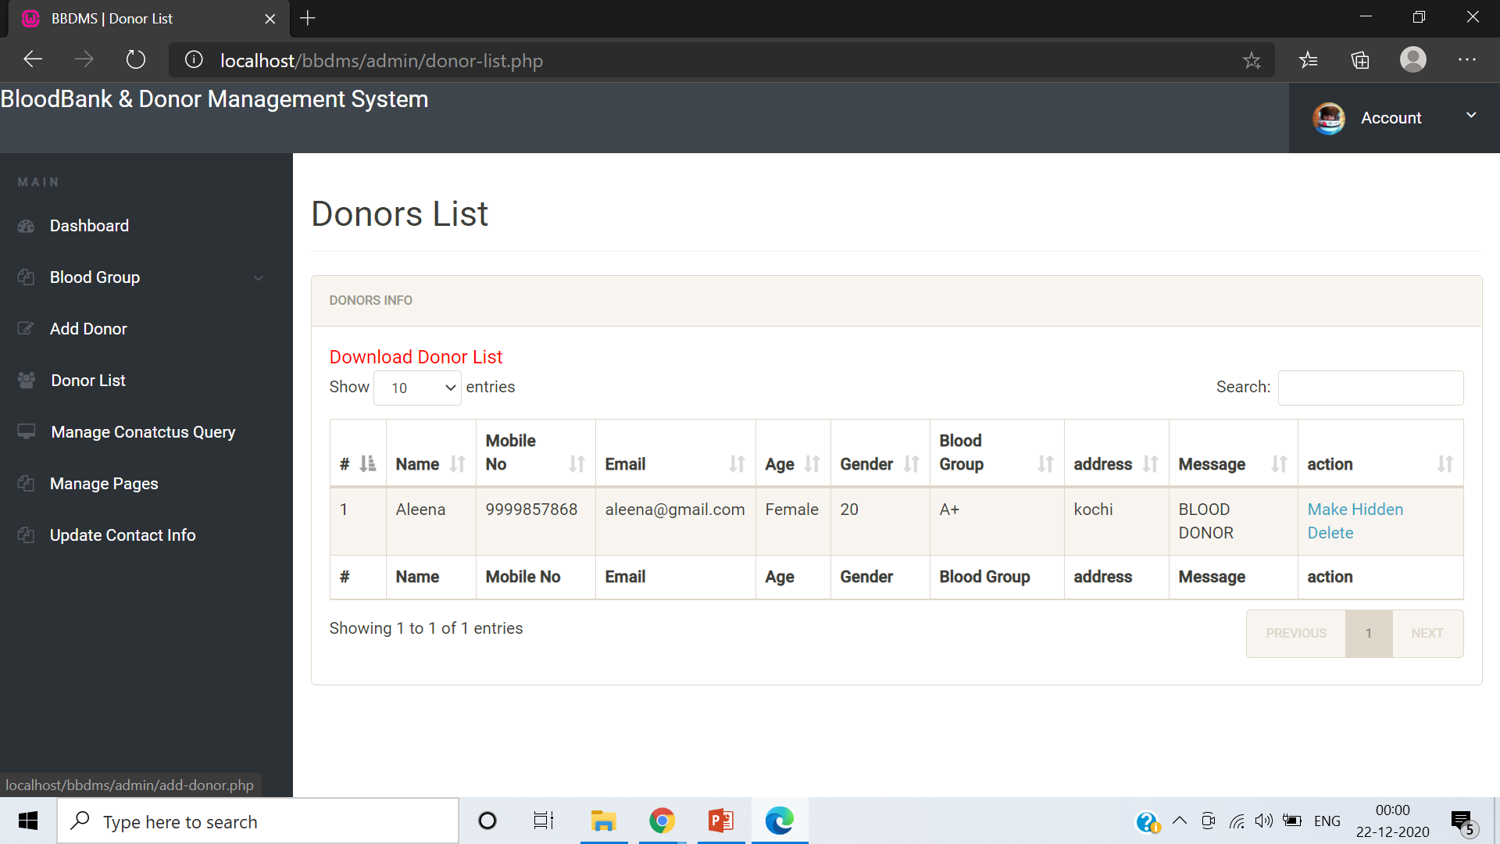
ADMIN PAGE - MANAGE DONOR

Slide 25
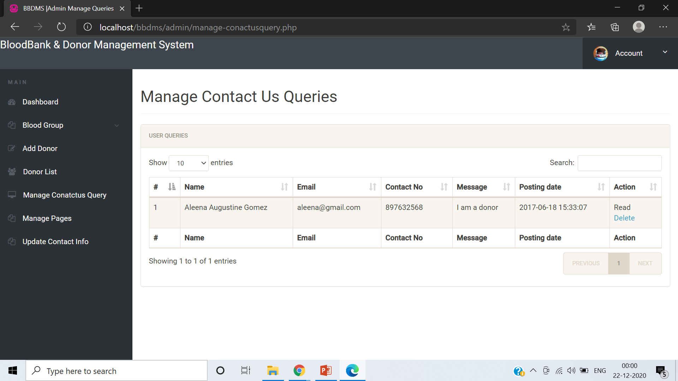
ADMIN PAGE – MANAGE QUERIES

Slide 26
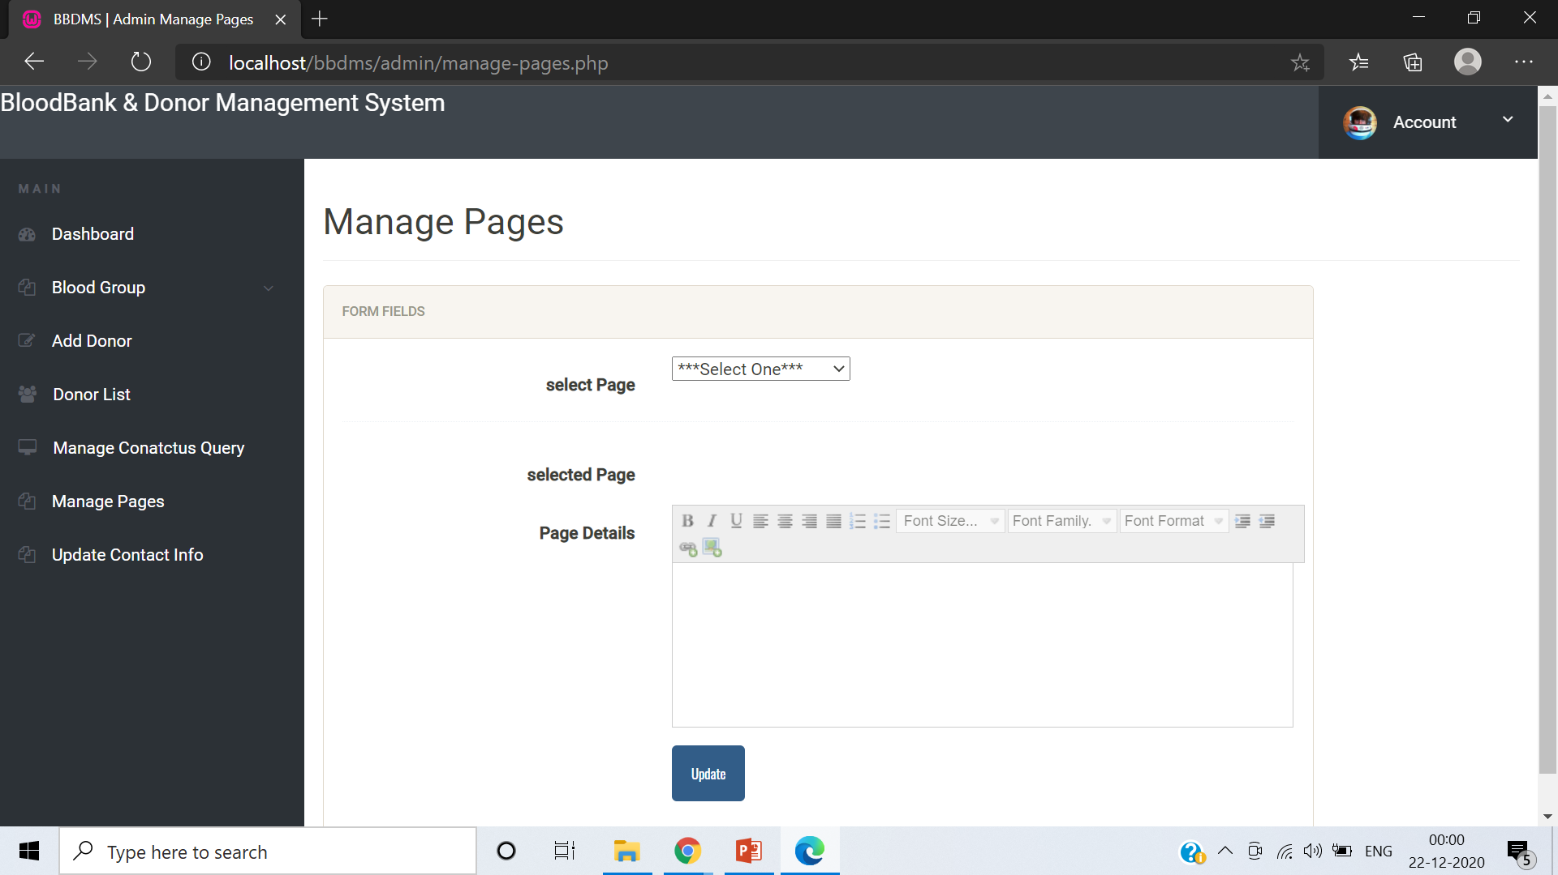
ADMIN PAGE – MANAGE PAGES

Slide 27
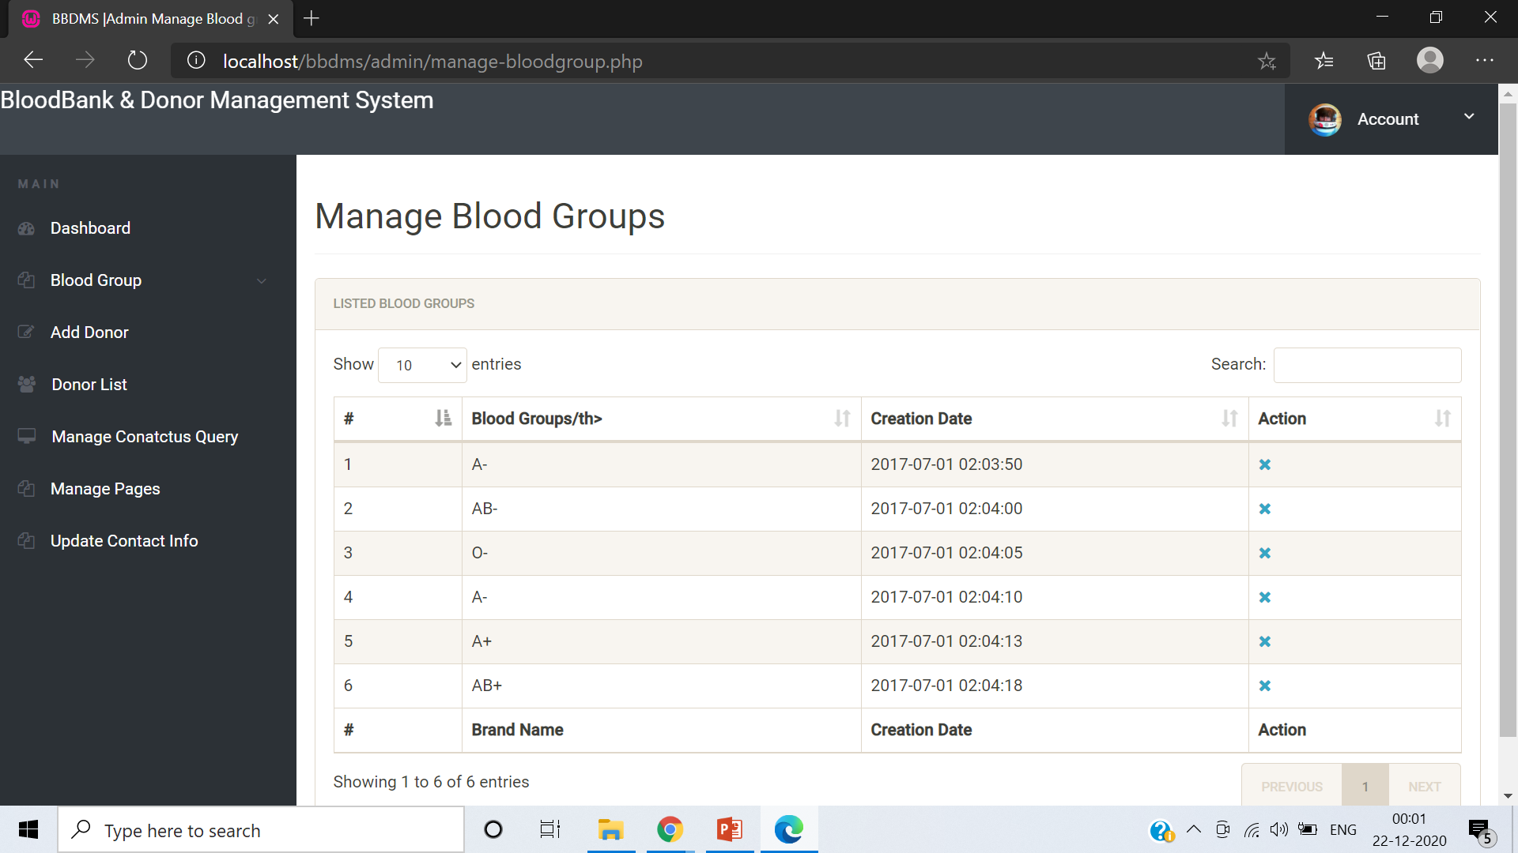
ADMIN PAGE – MANAGE BLOOD GROUPS

Slide 28
CONCLUSION
This system computerizes the blood transaction process in any blood bank. It manages the different operations in blood bank such as donor registration, storage etc. It has the searching option along with the managing capability. New features and modules can be added into the system as per user requirement.

Slide 29

THANK YOU

